Slide 1
PHYSIOLOGICAL RESPONSE AND EFFECTS OF HIGH ALTITUDE ON HUMANS
Group 27

Slide 2
Outline of Presentation
Introduction
Physiological Response To High Altitudes.
Effects on Humans.
Advantages and Disadvantages Of living in High Altitudes
Human Activities at High Altitudes.
Conclusion

Slide 3
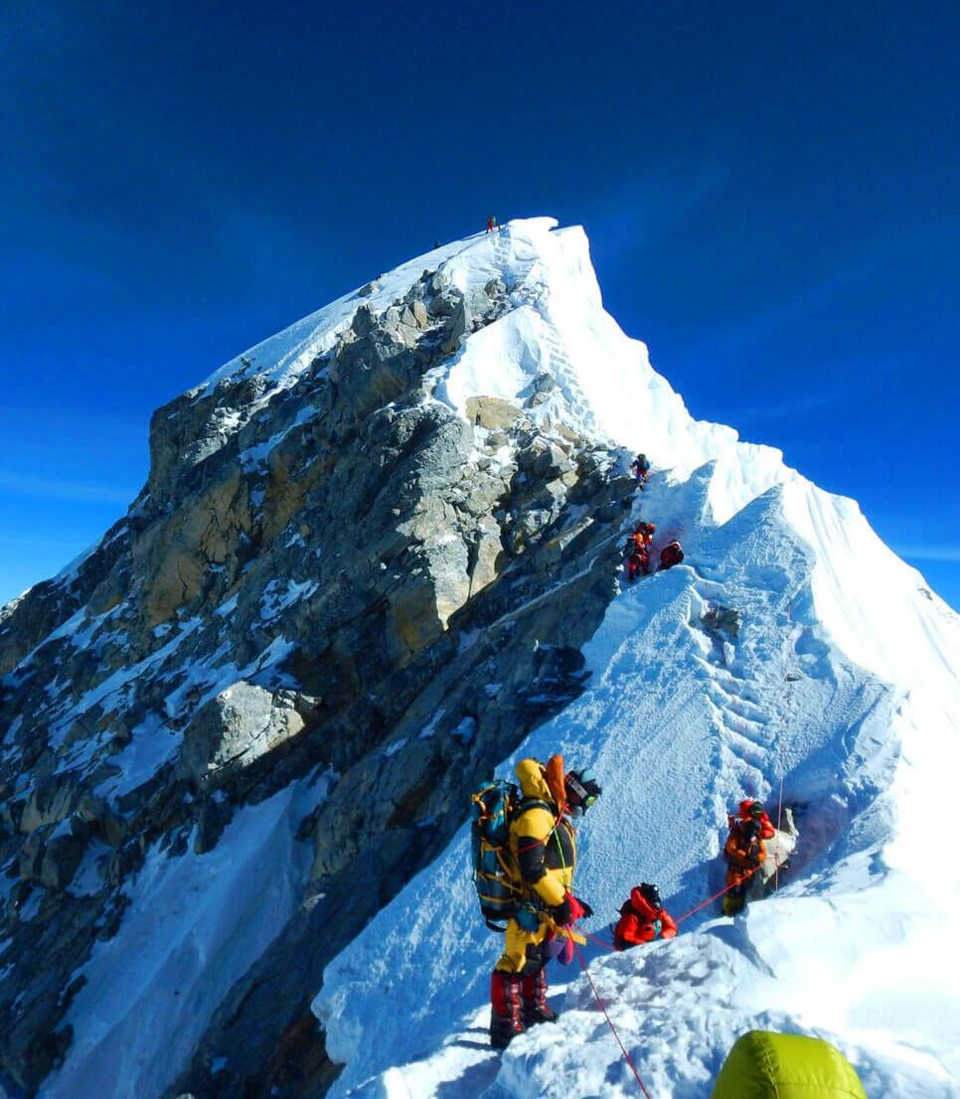
Introduction
High altitude are elevations lying above 2400 meters
(8000 feet) above sea level.
The most high-altitude
point on earth is Mount Everest
In the Himalayan Mountain Range.

Slide 4
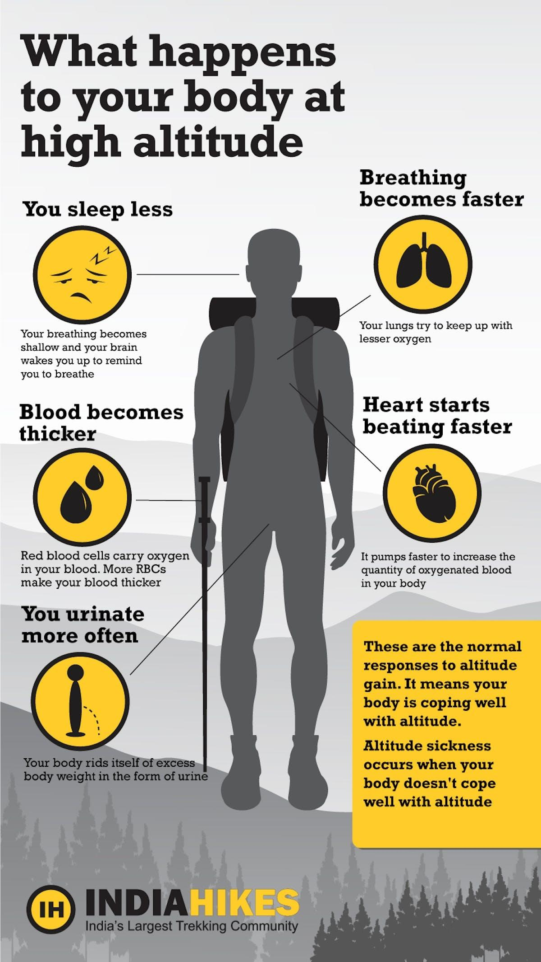
Physiological Responses to High Altitude
1. Hypoxia and Reduced Oxygen Levels
At higher elevations, the partial
pressure of oxygen
in the atmosphere decreases, leading
to hypoxia. Hypoxia affects the
oxygen saturation in the blood, resulting in
lower oxygen availability to body tissues.

Slide 5
Physiological Responses to High Altitude
2. Increased Breathing and Heart Rate
To compensate for the reduced oxygen, the body
increases the rate of breathing and heart rate.
This helps in delivering more oxygen to tissues
and maintaining adequate blood circulation.

Slide 6
Physiological Responses to High Altitude
3. Production of Erythropoietin and Increased.
Red Blood Cell Count.
Hypoxia triggers the release of erythropoietin,
a hormone
that stimulates the bone marrow to produce
more red blood cells. Increased red blood cell count
enhances oxygen-carrying capacity, aiding in adaptation to higher altitudes.

Slide 7
Acute Effects on Humans
The effects of high altitude on humans are mostly
the consequences of reduced Partial pressure
of oxygen in the atmosphere. The oxygen saturation
of haemoglobin determines the content of oxygen in the blood.
After the human body reaches around 2100 metres (6900 ft)
above sea level, the saturation of oxyhaemoglobin begins
To decrease rapidly.

Slide 8

Acute Effects on Humans
1. Acute Mountain Sickness (AMS)
AMS is a common condition experienced
by individuals rapidly ascending to high
altitudes.
Symptoms include headache, nausea,
dizziness,
fatigue, and difficulty sleeping.
Gradual acclimatization and staying hydrated
can help prevent and alleviate AMS.

Slide 9
Acute Effects on Humans
2. High Altitude Pulmonary Edema (HAPE)
HAPE is a severe condition involving
fluid accumulation in the lungs due to increased
pulmonary artery pressure.
Symptoms include shortness of breath,
cough with pink or frothy sputum, and weakness.
Immediate descent and medical attention
are essential for HAPE treatment.

Slide 10
Effects Of High Altitude on Humans
Effects of high altitude on the cardiovascular system
- Increased heart rate and blood pressure
- Decreased cardiac output
- Risk of arrhythmias and heart failure
Effects of high altitude on the respiratory system
- Increased respiratory rate
- Decreased arterial oxygen saturation
- Risk of pulmonary hypertension and respiratory failure
Effects of high altitude on the nervous system
- Cognitive impairment
- Headaches and dizziness
- Risk of seizures and coma

Slide 11
Effects of High Altitude on Humans
Acclimatization Process.
Acclimatization is the body's gradual adjustment
to higher altitudes over time.
It involves physiological changes that improve oxygen utilization, such as increased ventilation and improved capillary density.

Slide 12
Advantages of living in high altitudes
People living at high altitudes have a higher red blood cell count
which helps them carry more oxygen in their blood.
This can be an advantage for athletes who compete at high altitude like cross country skiers and long distance runners.
People living in high altitudes are less likely to develop
certain health conditions like heart disease or stroke.

Slide 13
Disadvantages of living in high altitudes
Extreme weather conditions such as cold temperatures and strong winds
Air here is very thin and dry which can cause breathing difficulties and dehydration .

Slide 14
Human Activities at High Altitudes
Mountaineering and Climbing.
Mountaineers face challenges due to reduced
oxygen levels, extreme weather conditions, and unpredictable terrain.
Aviation and Pilot Considerations.
Pilots flying at high altitudes must be aware of hypoxia risks and use supplemental oxygen when necessary.
Impact on Athletes and Sports Performance

Slide 15
CONCLUSION
Understanding high altitude's effects on humans is vital. Proper acclimatization and preparation help mitigate risks and enhance experiences in these challenging environments.

Slide 16
References
Young, Andrew J; Reeves, John T. 2002.
Huey, Raymond B,; Eguskitza, Xavier,(2nd July 2001)
Roach, R. C., Hackett, P. H., & Oelz, O. (1993). Lake Louise AMS scoring consensus committee. The Lake Louise acute mountain sickness scoring system. In Sutton JR, Houston CS, Coates G (Eds.), Hypoxia and Mountain Medicine (pp. 272-274). Burlington, VT: Queen City Printers.
Bärtsch, P., & Gibbs, J. S. (2007). Effect of altitude on the heart and the lungs. Circulation, 116(19), 2191-2202.

Slide 17
Group Members
1. Adjei De-graft 9195119
2. Damoah Grace 9206319
3: Aidoo Newlove 9197719
4. Kwofie Emmanuella 9211719
5. Amanin Kwarteng Abena Safowaa 9198319
6. Kelvin Oduro

